Slide 1
Quick Start: Groups

Slide 2
Objectives
After completing this lesson, you should be able to:
to group several dimension members into categories that don’t already exist in your data

Slide 3
Agenda
Overview of the Groups and methods to create a Group
Create a Group from the View
Create a Group using Visual Grouping

Slide 4
Overview of the Groups
Groups are useful for simplifying the display data when working with large numbers of dimension members.
Adding a group creates a new dimension with grouped members.
Groups combine dimension members into categories and enable you to analyze data as a group instead of as individual marks.

Slide 5
Methods to create a Group
Create a Group from the View
Create a Group from the Data Pane
Create a Group using Visual Grouping

Slide 6
Agenda
Overview of the Groups and methods to create a Group
Create a Group from the View
Create a Group using Visual Grouping

Slide 7
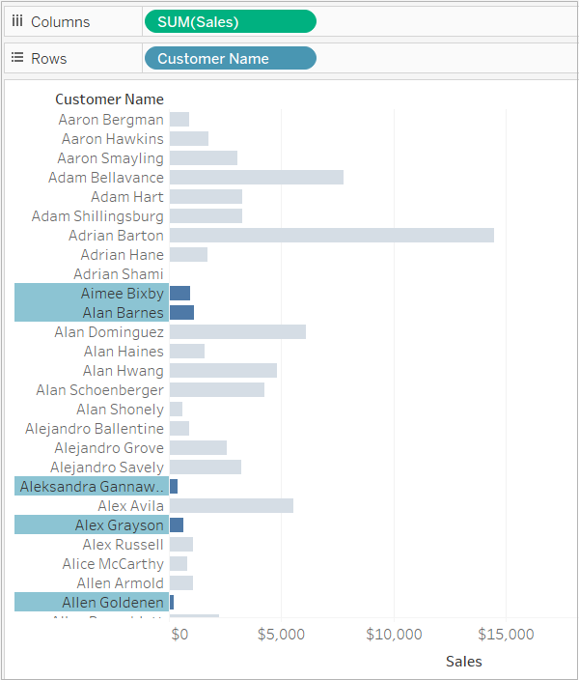
Select the members to group Select one or more members that you want to group.

Slide 8
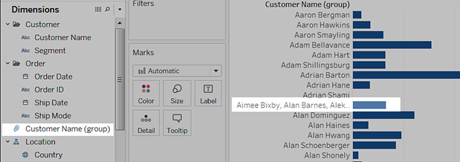
Click Group on the toolbar
Click the Group Members icon on the toolbar.
The members are grouped into a single member in the view and the new group field is shown in the Data pane.

Slide 9
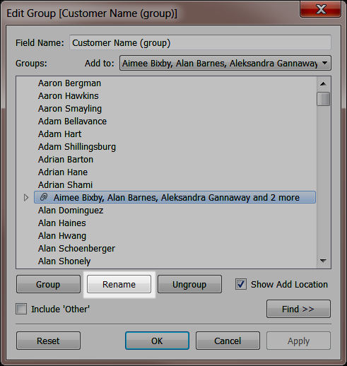
Edit the name of the group
In the Data pane, right-click (control-click on Mac) the grouped field and select Edit Group. Select the group and then click, Rename.

Slide 10
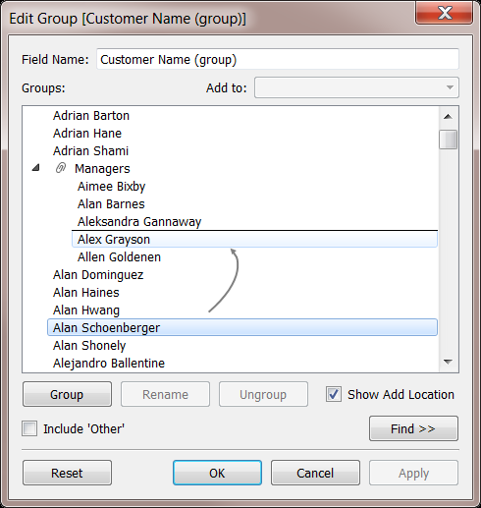
Add and remove members
In the Edit Group dialog box, add and remove members by dragging and dropping the selected members in the list to and from the group.
Finding members
If you are working with a dimension that has a lot of members, you can search and select members that match a specific criteria using the Find button in the Edit Group dialog box.

Slide 11
Agenda
Overview of the Groups and methods to create a Group
Create a Group from the View
Create a Group using Visual Grouping

Slide 12
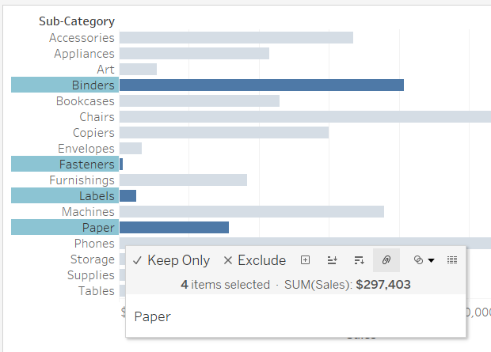
Select headers
One way to create a group is by selecting multiple headers in a table or values in a legend and then clicking the Group option (which looks like a paperclip) in the tooltip.

Slide 13
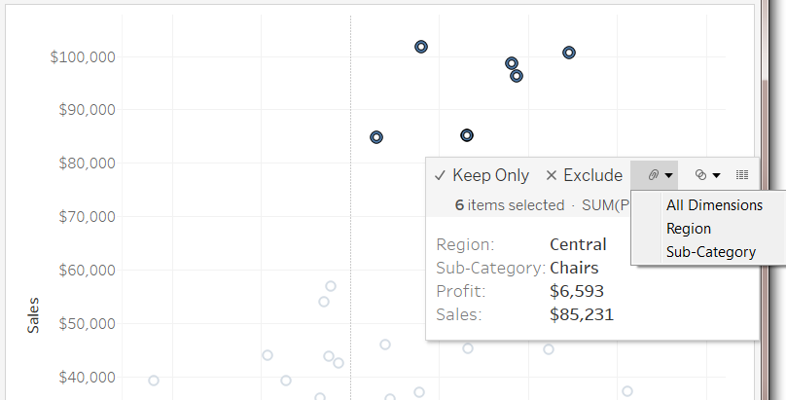
Select marks in the view - all dimensions
If you want to visually call out a set of marks in your view instead of combining them into a new mark you can create groups by selecting marks directly in the view and then select Group on the tooltip.
Grouping on all dimensions creates a category that includes each relevant combination of Sub-Category and Region. These combinations are grouped into a single category and everything else is put in the Other category.

Slide 14
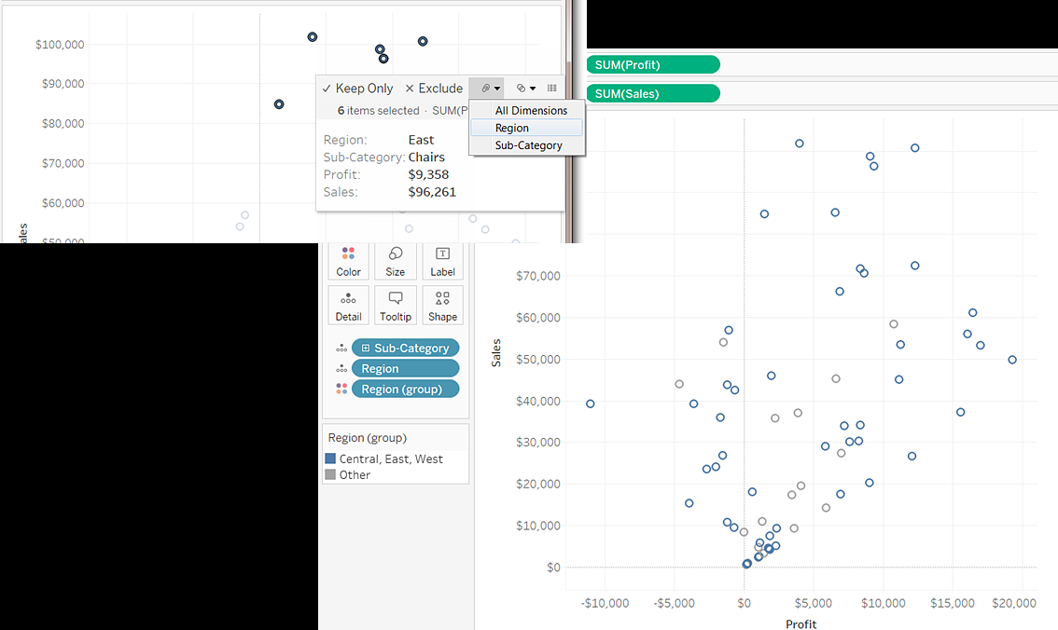
Select marks in the view - specified dimensions
Grouping selected marks on a specific dimension and then selecting a specific dimension from the Group menu on the tooltip creates a group based on that dimension.

